Slide 1
Customer Register eCommerce
FEBRUARY 2018
LIMA

Slide 2
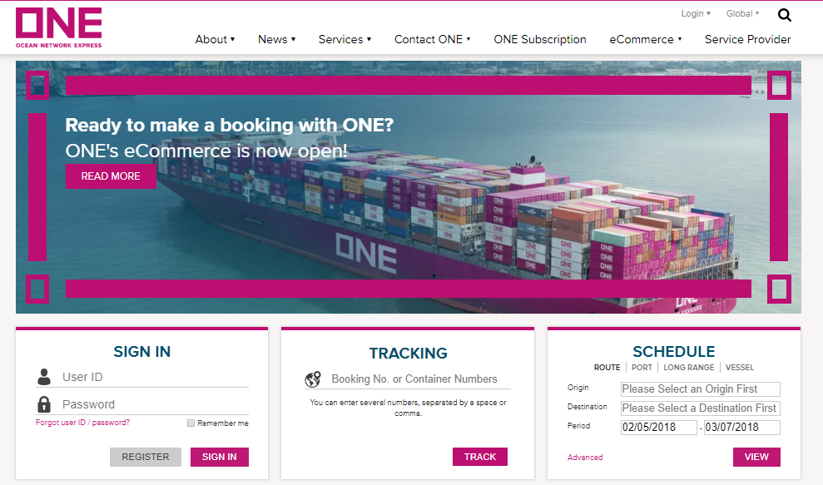
1) Enter to the link www.one-line.com

Slide 3
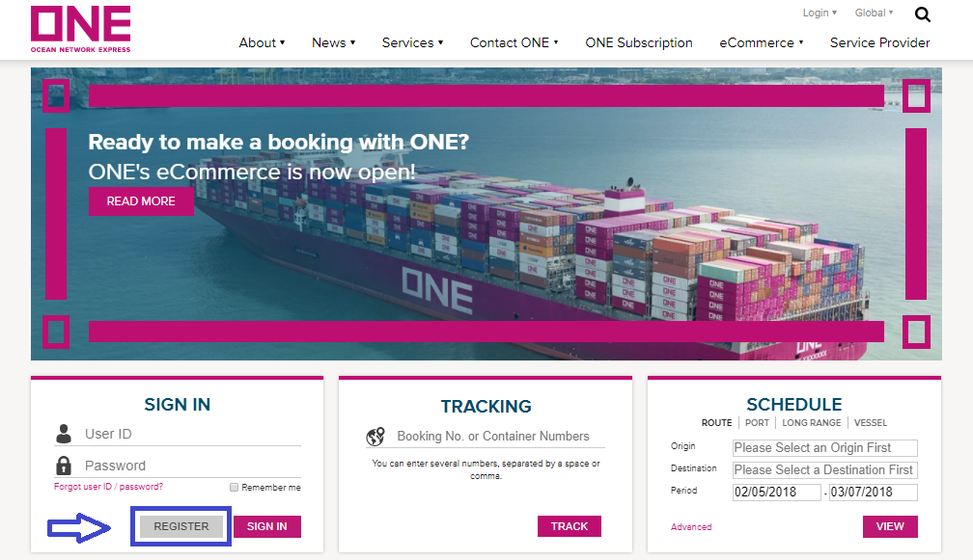
2) Select button “Register”.

Slide 4
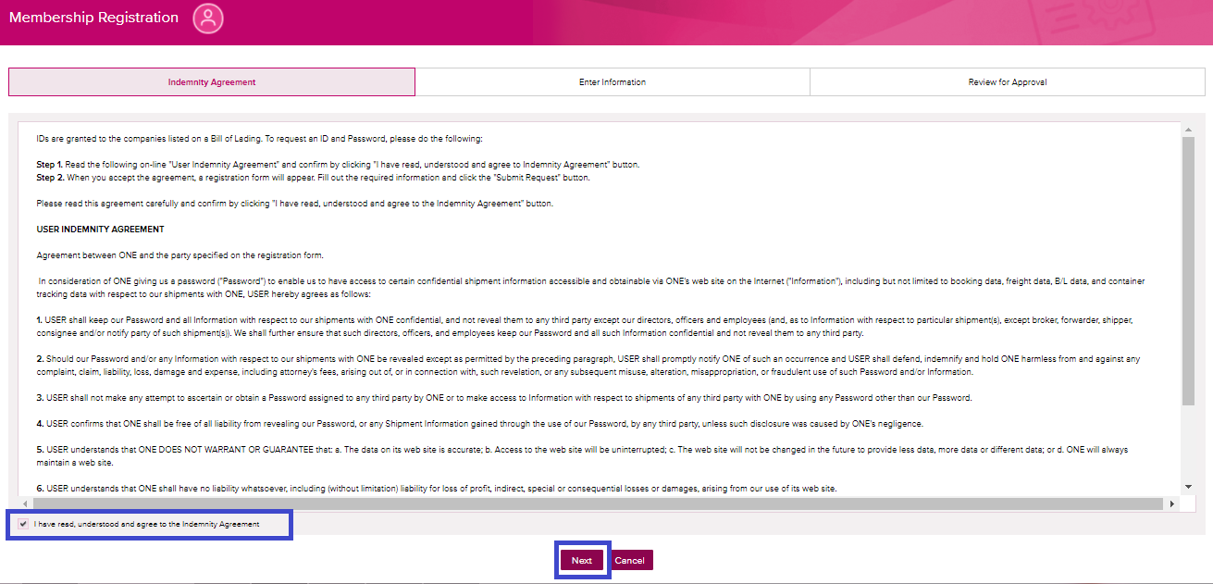
3) Accept User Indemnity Agreement and click Next button.

Slide 5
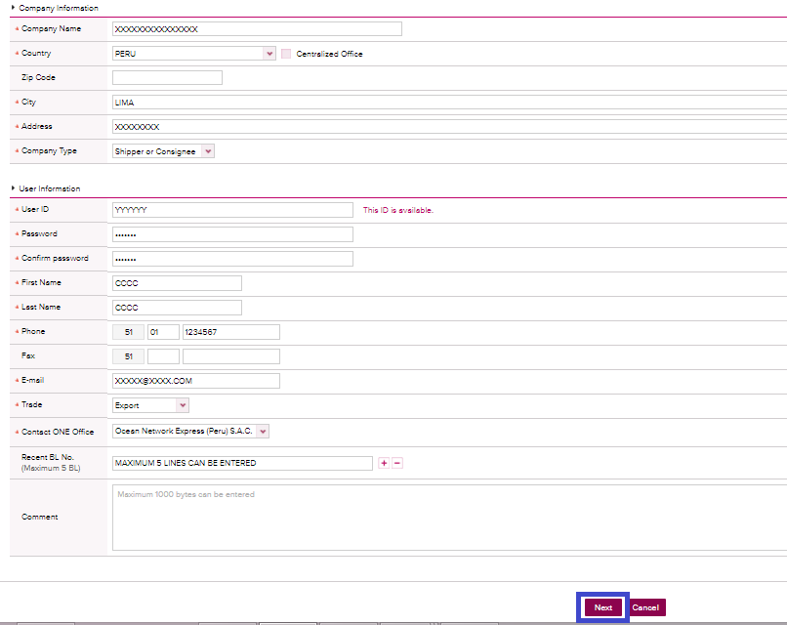
4) Complete all the information requested and click Next button.

Slide 6
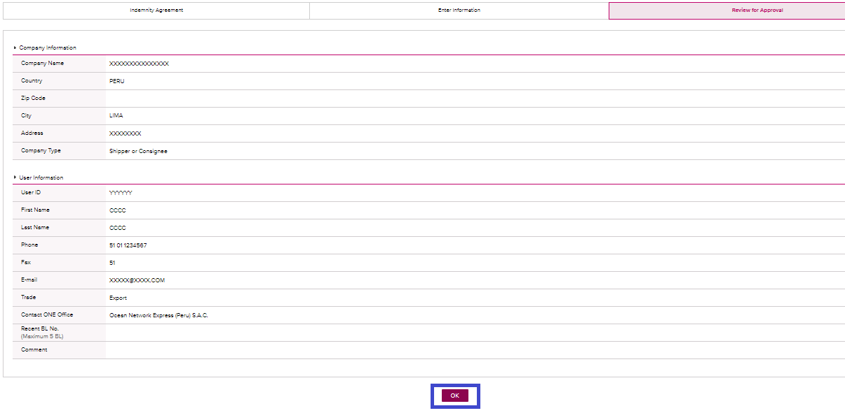
5) Review the information and click OK button.

